Slide 1
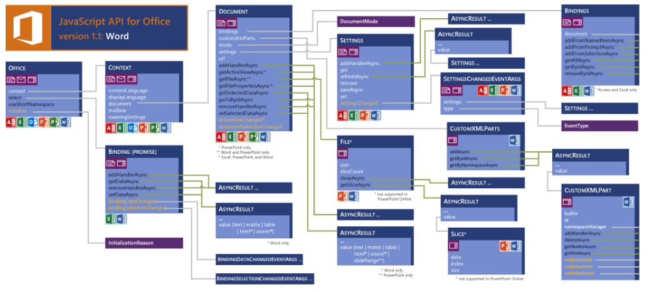
JavaScript API for Word Apps (v 1.1)
see more at https://msdn.microsoft.com/en-us/library/office/fp142185(v=office.15).aspx

Slide 2
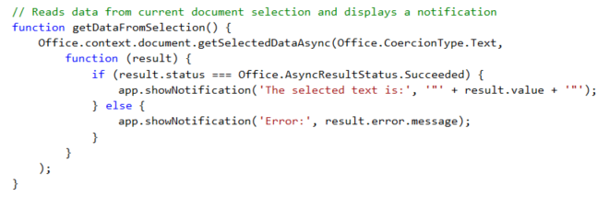
getSelectedDataAsync()
Use this function to read from document select
Notes:
The function getSelectedDataAsync is used to read content from the selected region of the current Word document.

Slide 3
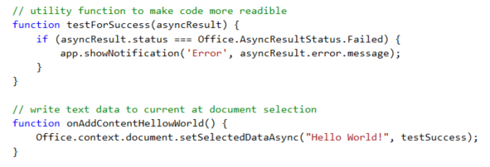
setSelectDataAsync()
Use this function to insert content into document
Notes:
The function setSelectedDataAsync is used to write content into the selected region of the current document. If there is no selected region, the content is added at the location of the cursor.

Slide 4
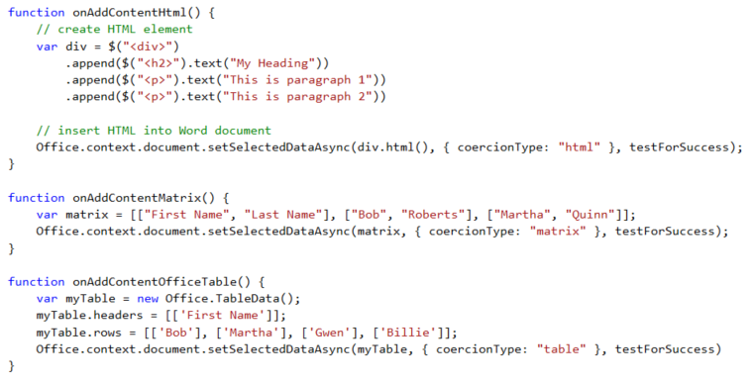
Coercion Types
Coercion types make it possible to read/write content in different formats
text - string value
html - HTML content
matrix - array of arrays
table - table of rows and columns
ooxml - Office Open XML format

Slide 5
demo
Writing Content To the Selected Region of a Word doc

